Slide 1
<CovidVac>
<Rookies>
<Trivandrum>
haQathon 2020
Global Product Engineering and Lifecycle Services Company
Notes:
Talking points:
We have built QuEST over the last 21 years as a aspiration driven organization. We continue to push the boundaries, create new frontiers across multiple safety critical and hi-tech industries we serve. We do this by offering our Customers a range of Services and Solutions and engagement models that spans – Engineering, Enterprise solutions, Operations, Supply Chain and Technology enabled solutions covering the complete product lifecycle.
As such, QuEST is a Leading Global Product Engineering and Lifecycle Services Company
In this presentation we will cover 3 aspects of QuEST.
WHO we are, WHAT we do and for WHOM, and why we are in business – our purpose
Then we move on to HOW we engage with Customers
Finally we will cover HOW we are different and can add unique value to you and help you “Create the Frontier”

Slide 2
Distribution of Covid-19 Vaccine using Machine Learning
Team Name : Rookies
Mentor | : | Siji Geevarghese
Ideator | : | Team Idea
Team Lead | : | Rinta J Pomson
Team Members | : | Aswathi Suresh, Annu P Sunny, Bhavana A Rao
Notes:
Idea/Solution/Prototype: Give a one-liner about the solution for the given problem statement
Team Name: Add team name to the entry field
Mentor Name: Add mentor’s name to the entry field
Ideator Name: Add ideator’s name to the entry field
Team Lead Name: Add team lead’s name to the entry field
Team Members Name: Add team member’s name to the entry fields one after another

Slide 3
Scope
Problem Statement
Approach
Outcome
Post Covid-19, the most vital aspect is the distribution of vaccine across a specific region. Today, we don't have a mechanism to effectively decide the criteria as to who will receive the vaccine first.
Therefore, establishing an effective algorithm to vaccinate citizens is of paramount importance. Also educating them about the same is a prime concern.
Generate mock data(personal data, medical data, area data)
Define the sample set of rules to identify the priority of citizens for vaccination
Find the most suitable data classification tool
Create a rank-based dataset after applying rules
Train the model using the created data set
Use the model and find the accuracy
An Application that can be used by the government to effectively rank the citizens based on various attributes and find the most prone area & decide on who should get the vaccine first.
Notes:
Problem Statement: Illustrate the basic problem along with technologies used
Approach: Methods planned to solve the target problem in order to attain a viable solution within the constrained time of 2 days of hackathon
Outcome: Results obtained as part of development towards the end of hackathon to be demonstrated with the help of table, diagram if any

Slide 4
System Architecture
Training Dataset
Personal Details
Area Details
Medical Reports
Apply rules (Processing)
Train using Random tree classifier
Generate MODEL
Front End
Testing Dataset
Personal Details
Area Details
Medical Reports
Use generated MODEL
for testing
Results
Dashboard
Notes:
System Architecture: Outline & detail the basic architecture of prototyped solution with the help of block diagrams, etc. if any

Slide 5
Algorithm
TRAINING THE SYSTEM
TRAINING DATASET
Personal Dataset
ID
Classify
Merged
Dataset
Calculate Personal score
Find the Rank
Using
RANDOM FOREST CLASSIFIER
Generate
MODEL
Medical Dataset
Area Dataset
Area Result Dataset
TESTING THE SYSTEM
MODEL
Find the Rank
TEST DATASET

Slide 6
Technology Choices
Sl. No. | Technologies used | Rationale for selection
1 | Machine Learning (Algorithm : Random Forest Classifier) | When exposed to new data, they can independently adapt & learn from previous computations to produce reliable, repeatable decisions and results
2 | Angular(Front End) | Angular is an open-source front-end and data binding is very easy
3 | Flask (framework) | Highly customisable framework. Interface between front end and backend.
4 | Pandas | Is an open-source data analysis and manipulation tool. It offers data structures and operations for manipulating numerical tables
Notes:
Technology Choice: Add technologies used and rationale for selecting so

Slide 7
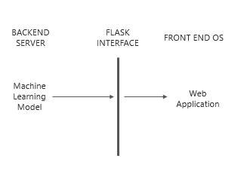
Business Case
Product Deployment
Value Added to QuEST / Customer
Relevant in the present scenario
QuEST can use this idea to make a societal difference
Notes:
Product Deployment: How the Solution Can be Deployed? -- Target Environment, What is needed, etc.
Value Added to QuEST: Business Benefits? -- How QuEST can benefit; be specific about customer, VBU etc.

Slide 8
Learning Points
Key Learning
Scope for Improvement
We got the exposure to learn different languages and technologies
Python
Angular
Machine Learning
We learnt how to work virtually and yet effectively
Provide a user login to query about their most likely date of vaccination
Extend to larger and diversified datasets
Adapt to the new set of rules defined by the government
Training of dataset can be done using data analytics
Notes:
Key Learning: Team Experience, Bottle necks, “Aha” Moments, etc.
Scope for Improvement: How the solution can be improved further?

Slide 9
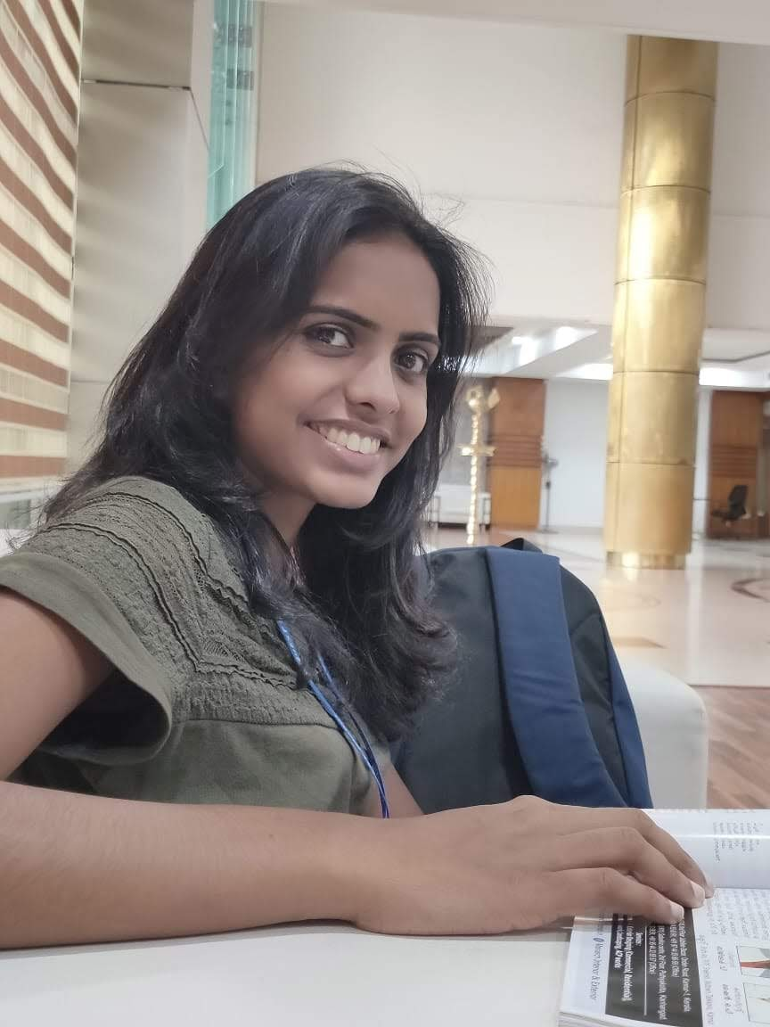
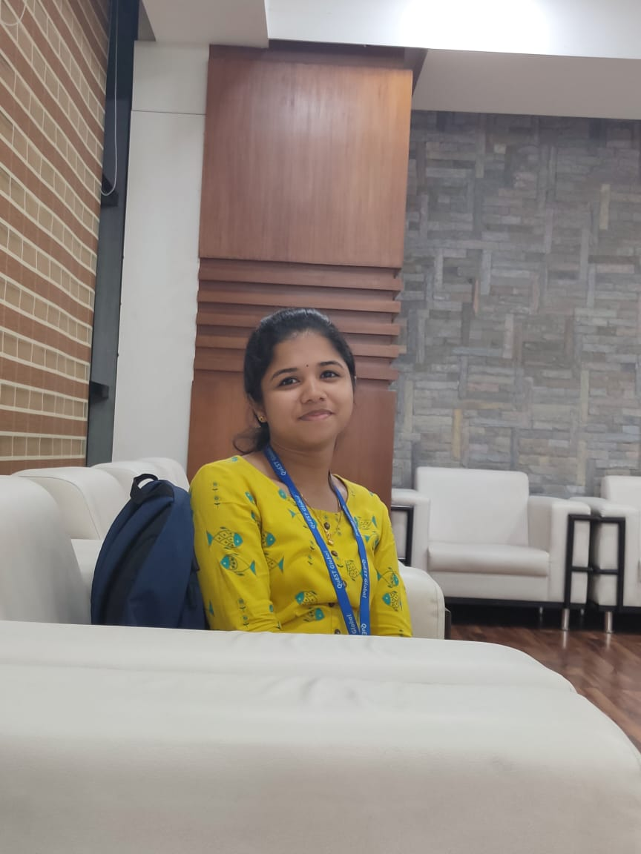

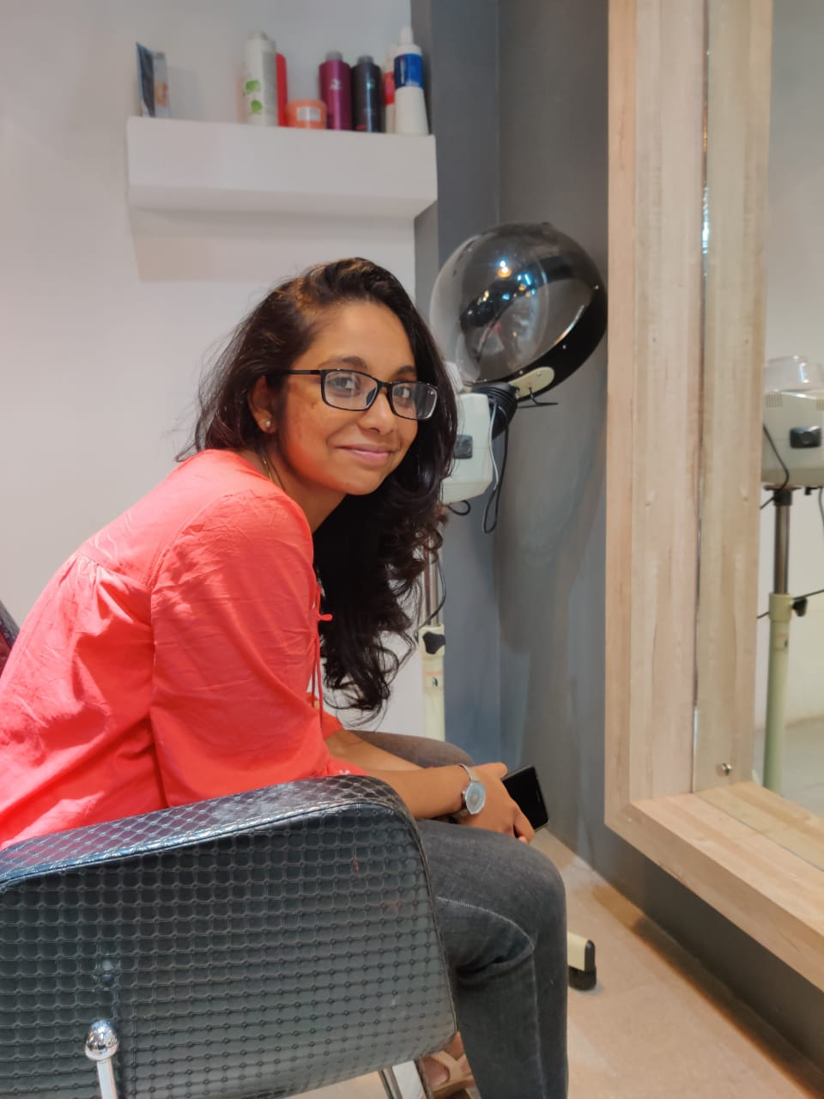
The Experience
The Team
As we all are participating for the first time in this event, we had a great experience of learning.
We learnt how to deal with a problem and come up with the various ways of approaching towards the solution.
We also learnt how to find the right technology for our problem statement.
Notes:
THE EXPERIENCE: Add one liner by team member(s) as well as mentor about their overall hackathon experience. Teams may mention about learning something new, meeting new people, explain the process of building stuff, testing and validating their technical skills, etc. Mentor may talk about working with the team and their achievement at the hackathon.
PHOTO: Add picture of the team along with their developed prototype

Slide 10
Thank You
Engineering | Enterprise Solutions | Operations & Supply Chain | Technology & Digital Solutions

